Slide 1
Managing Privacy ODPi Data Privacy Pack
12th July 2018

Slide 2

TODAY’S Speaker
Lead for the Data Governance PMC and maintainer for the Egeria open source project
https://github.com/odpi/data-governance
https://github.com/odpi/egeria
Mandy Chessell, IBM Distinguished Engineer

Slide 3
Introduction to ODPi Egeria/Data Governance
Open Source Projects
Data Governance PMC - Governance Best Practices
Egeria – Metadata and Governance Interoperability
https://github.com/odpi/data-governance
https://github.com/odpi/egeria

Slide 4
ODPi Data Privacy Pack
Best practice guides, resources and technologies
All open source
Designed for people responsible for ensuring data privacy in an organization (the privacy officer)

Slide 5
Agenda for today’s webinar
Why privacy?
The digital services lifecycle and privacy
Introducing Coco Pharmaceuticals
Building a new mobile application using digital data
Data science and privacy
Extensions to Egeria
Summary and next steps

Slide 6
The Privacy Challenge

Slide 7
Why focus on privacy?
Recent legislation, such as the European Union General Data Protection Regulation (GDPR) establishes specific requirements that impact all organizations that processes personal data.
The definition of personal data is very broad.
The requirements and new rights of data subjects have a broad impact on the way that organizations operate.
Privacy is now an important topic for all.

Slide 8
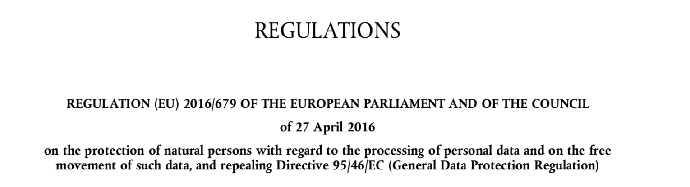
European Union GDPR
https://ec.europa.eu/commission/priorities/justice-and-fundamental-rights/data-protection/2018-reform-eu-data-protection-rules_en

Slide 9

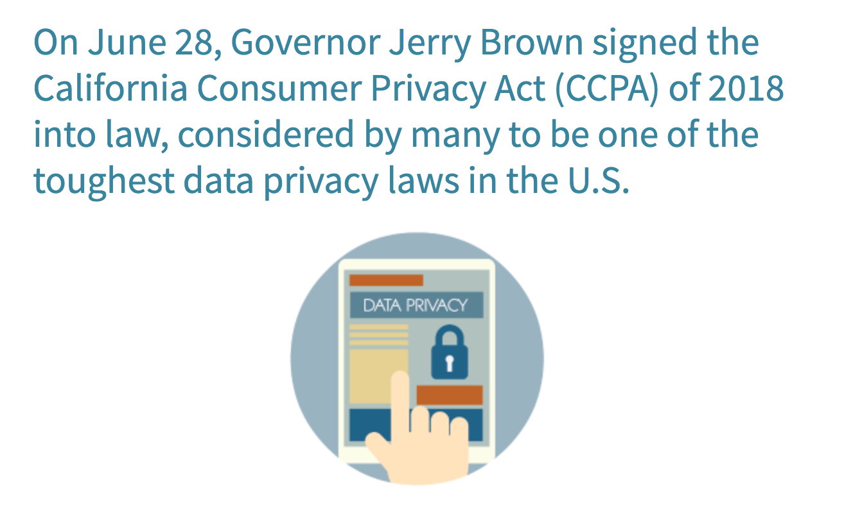
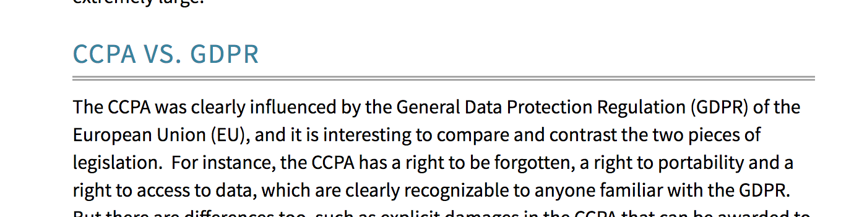
Privacy legislation is spreading
https://www.caprivacy.org/
https://www.firstsanfranciscopartners.com/blog/california-consumer-privacy-act-of-2018-vs-gdpr

Slide 10
Introducing Coco Pharmaceuticals

Slide 11
Coco Pharmaceuticals ← fictitious organization
Coco Pharmaceuticals (CocoP) is vertical integrated, with its own research, manufacturing, sales and distribution services.
Its business model is focus on supplying unique targeted medication for cancer suffers. in recent years, their focus has been on personalised medicine - where a patient's genome is used to determine the right course of treatment.
Coco Pharmaceuticals has research partnerships with universities in order to collaborate on further research.

Slide 12
Coco Pharmaceuticals Persona
https://odpi.github.io/data-governance/coco-pharmaceuticals/personas/

Slide 13
Privacy Officer

Slide 14
Faith Broker
Faith's main role is the director for Human Resources.
This is a new role for her and she is keen to improve the way employees are managed.
Prior to becoming HR director, she was a highly experienced auditor for Coco Pharmaceuticals.
She still monitors the regulations and suggests changes to business practices to ensure the company is granted the licenses it needs to stay in business.
Periodically she performs internal audits so they are ready for when external auditors turn up.
She has recently taken on the role of privacy officer since this dovetails well with her HR role and experience in compliance.

Slide 15
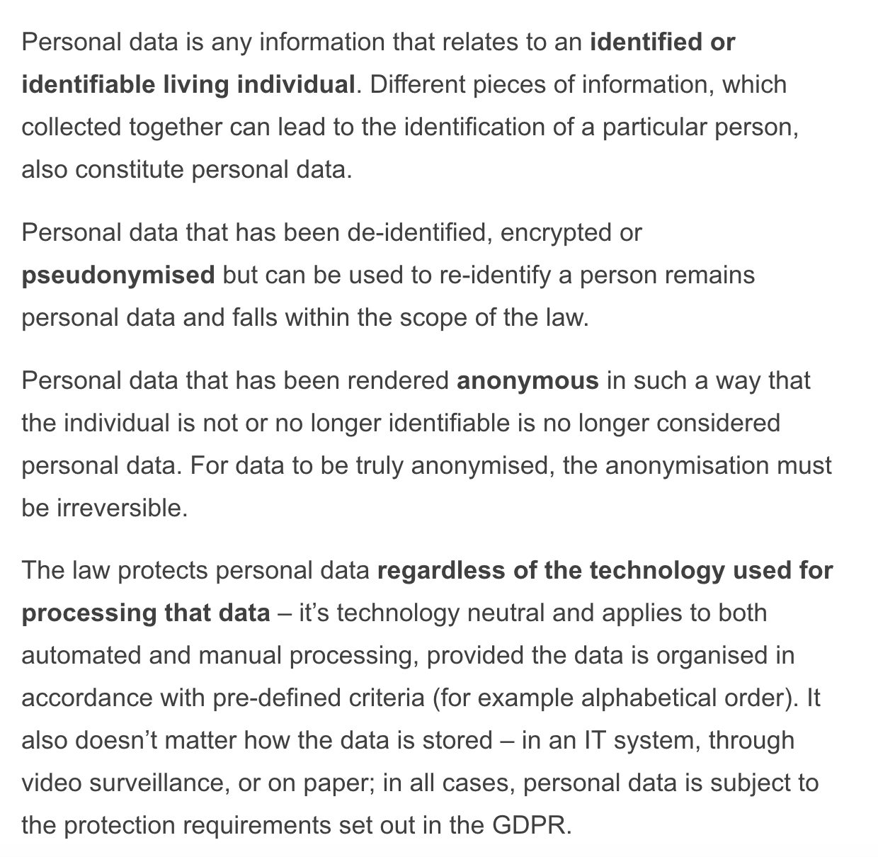
What is personal data?
https://ec.europa.eu/info/law/law-topic/data-protection/reform/what-personal-data_en

Slide 16
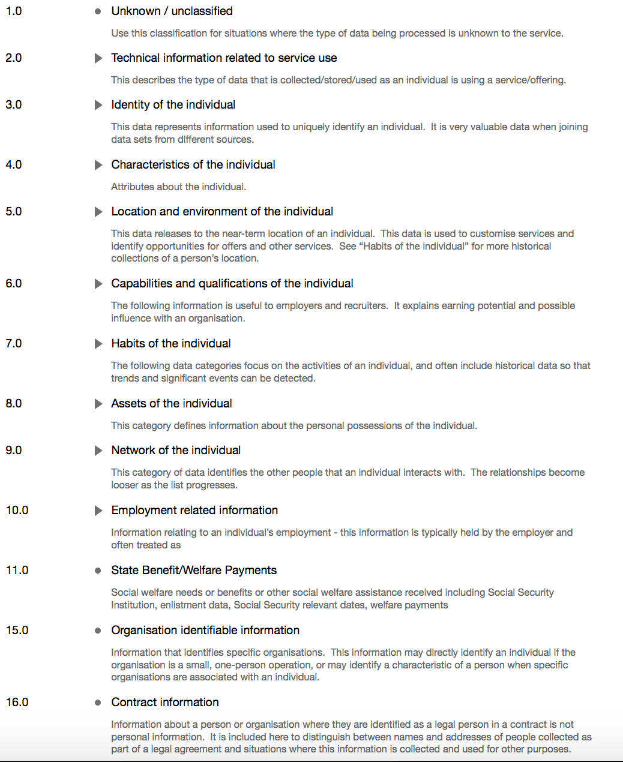
Personal Data Categories
From the ODPi Data Privacy Pack
https://github.com/odpi/data-governance/blob/master/data-privacy-pack/ODPi%20-%20Personal%20Data%20Categories.pdf

Slide 17
Digital Service Lifecycle

Slide 18
Most digital services should design for processing personal data
The definition of personal data is expanding so rapidly it is safest to assume personal data is typically being processed. For example:
Most processing is happening on behalf of a person or organization often from multi-use personal devices.
IoT data often refers to a place or asset that is tightly associated with a person or small group of people.
Minorities have easy to determine unique characteristics that make it easy to derive more sensitive information about them.
Many organizations should govern their digital services assuming they are processing personal data by default and have an exception process to certified a service as not processing personal information.

Slide 19
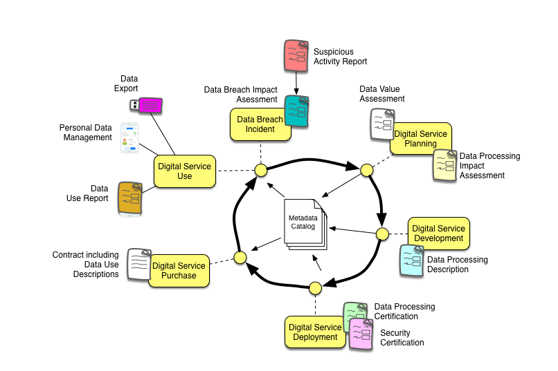
Digital Service Lifecycle

Slide 20
Building a new digital service

Slide 21
Overview of the scenario
Tessa Tube is a researcher at Coco Pharmaceuticals. She is developing new personalised cancer treatments. Her work combines analysis of data, and results of other researchers, plus clinical trials.
Tessa is about to start a new clinical trial and wants to improve the quality and quantity of data collected during a clinical trial. She has the idea that the medical staff and patients could be given tablets to record information about the clinical trials as they are in progress.

Slide 22
Initial discussions
Tessa discusses this project with Jules. She needs his advice and agreement to move the project forward because it will include sensitive and personal data plus clinical trial results that must conform with FDA regulations.

Slide 23
Five key questions to answer
How do they ensure the data accessed by, and stored on, the mobile device is safe?
How do they ensure the data entered on the mobile device is valid and comes from an authorised/authenticated person?
How do they safely move the data collected into their data lake so Tessa's team can analyse the results throughout the clinical trial?
How do they manage the data in the data lake?
How do they demonstrate the validity and lineage of the results and conclusions they have from the clinical trial to an FDA inspector?

Slide 24
Initial sketch of the clinical trial’s solution
Erin outlines how such a solution could be secured and governed.

Slide 25
Additional questions from Faith
What is the scope and type of data used and what is its value to the application/organization?
What are the privacy risks involved?
How is consent for processing of personal data handled?
How are the data subject’s rights to be supported?

Slide 26
Digital Service Lifecycle

Slide 27
Data Value Assessment
Understand what data is required to support the digital service.
Why is it needed?
How long is it kept?
Aim to ensure only data that is needed is acquired, processed and stored for the minimum amount of time.

Slide 28
Data Processing Impact Assessment
Describe nature of the processing
Risk to individuals
Mitigation of risk
https://ico.org.uk/for-organisations/guide-to-the-general-data-protection-regulation-gdpr/accountability-and-governance/data-protection-impact-assessments/

Slide 29
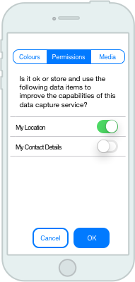
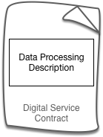
Digital Service Purchase and Use
Consent Management
Legitimate Interest
Explicit Consent

Slide 30
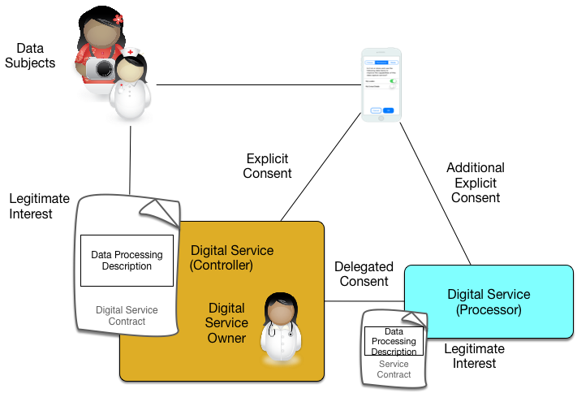
Consent Landscape

Slide 31
Data Subject Rights
https://ico.org.uk/for-organisations/guide-to-the-general-data-protection-regulation-gdpr/individual-rights/
The right to be informed
The right of access
The right to rectification
The right to erasure
The right to restrict processing
The right to data portability
The right to object
Rights in relation to automated decision making and profiling.

Slide 32
More detailed solution design

Slide 33
Data processing descriptions
Each digital service must create a description of the data it uses and how it processes it. These descriptions will become part of the digital service’s terms and conditions.
The processing description will identify the categories of data being processed, the purpose of this processing, where this data is stored and the scope of the offerings that this data is made available too.
The aim of this processing description is to specify the offering’s legitimate interest in the data. When the client signs up to the offering they accept the offering’s terms and conditions. This acts as the controller to processor agreement on how we will process the data they give us.

Slide 34
Structure of the data processing description
A data processing description for a digital service defines:
Each data set managed by the offering
The data categories of data in the data set
The personal data classification of the data set
The scope of use of the data set
The storage technology and location(s)
A set of processing descriptions that describe how the data is processed, its purpose, and what happens to the results.
For example: Observed usage data is collected when an end user interacts with the offering in order to improve the capabilities of the service. This data is stored in the service activity data set and kept for no longer than 6 months.
The data processing descriptions need to cover all parts of the lifecycle of a service’s use including user on-boarding, normal use, support and maintenance of the digital service(s) and tenant termination.

Slide 35
Red flags relating to processing statements
There are data sets declared that are not used
Not all of the lifecycle states of the offering are covered
There is no view of the lifecycle of the data set – for example, what causes data in the data set to be created, updated and deleted.

Slide 36
Digital Service Development
Des is a contractor.
He is responsible for the mobile/tablet app development including security, consent management and the data subject rights services.

Slide 37
Integration services
Bob Nitter is an experienced integration developer. He is given responsibility for developing the backend of the clinical trials engagement application.

Slide 38
Integration services
1) Designing the mobile APIs to minimise the flow of personal and sensitive data between the device and the application.
2) Recording the schema for these APIs one of the open metadata repositories and classifying the schema attributed with business glossary terms.
3) Encrypting any data stored in the Mobile application. This data is kept to a minimum - just containing enough basic information to drive the application on the device.
4) Using secure connections with the data refinery to send new sensitive data received back to the data lake rather than storing it locally in the cloud application.
5) Ensuring the usage, receipt of new data and transmission to the data lake are logged (with the clinical and personal data encrypted in the log file).

Slide 39
Data processing certification
Does the digital service (only) process data in the way described in the processing description?
Test evidence
Deployment protection
Professional review

Slide 40
Deployment
Gary Geeke is responsible for all of Coco Pharmaceuticals IT systems.
He is responsible for ensuring the deployment platform for the solution is secure.

Slide 41
Security Certification
Follow an established security certification standard that is relevant for your industry.
ISO, CSA STAR, FEDRAMP, SOC2, …
Both staff and systems need to be certified.

Slide 42
Data use report
Metrics about the data use within the digital services
Number of identified individuals
Volume of transactions and data change
Consent settings
Data subject requests
Other feedback.
Used for on-going assessment of risk and establishing what is normal processing

Slide 43
Data breach incident
When personal data is obtained by an unauthorized party
The affected organization may be the last to know
Can be uncovered when data is sold or seized by law enforcement agencies
Organizations need active monitoring of suspicious activity
Implies you need a good grasp on what is “normal”

Slide 44
Managing data breaches
In the event of a data breach, a team of experts for the digital service come together to support the organization’s response to the incident.
The executive team should organize rehearsals and assess the organization’s preparation for handling a data breach.
Who is responsible for communications with …
Regulator? Affected data subjects? Media ?

Slide 45
Who should support the data breach incident?
Incident Owner
Security Officer
Privacy Officer
Data Officer
Asset Owner(s)
Architect
IT Administrator

Slide 46
Data Breach Impact Assessment
Details of incident, how it was detected and root cause (if known.
When incident happened: Date/time → period of loss
Volume of loss
Individuals impacted
Risk and damage

Slide 47
Data Science Example

Slide 48

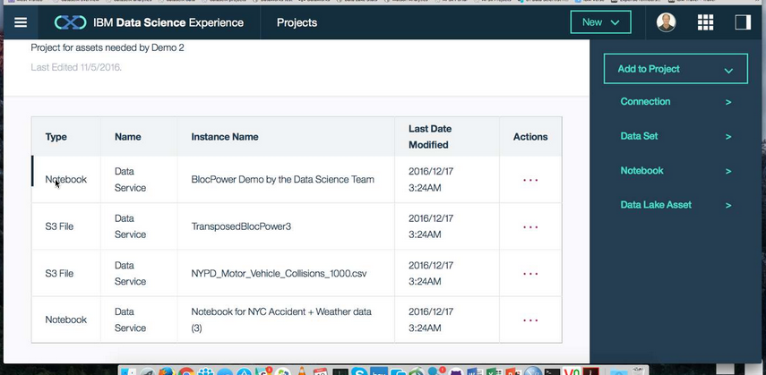

The perils of reusing data …
Callie Quartile
Data Scientist
Callie Quartile uses (1) open data from the local government registrar and (2) data from the employee directory to (3) create a birthday card service for the company.
Open Data
Site
Data Lake
1
3
2
Employee Directory

Slide 49

The perils of reusing data …
But its not my birthday
Callie Quartile
Data Scientist
Happy
Birthday
Unfortunately the obvious date in the registrar record was the registration of birth date not the date of birth. Date of birth was not published in the open data.
Callie needed better information about the open data to realise she had the wrong data.
Open Data
Site
Data Lake
1
3
2
Employee Directory

Slide 50
Even though this is an internal service …
Cataloguing and classifying all data stores (even from open data sites)
Evaluation of services as they are deployed.
Staff training

Slide 51
The (Meta)data Catalog(ue)

Slide 52
Digital Service Lifecycle

Slide 53
Data Processing Descriptions are a key part of the metadata catalog

Slide 54
Extensions to Egeria

Slide 55
Today’s reality

Slide 56
What needs to change?
Open and
Unified Metadata

Slide 57
Open metadata management ecosystem
Peer-to-peer network of repositories
Metadata stored and managed close to its source
Each repository/tool brings unique value.
Open, extensible metadata structures for metadata exchange and federation – extending coverage of the types of resources that need to be described.
Open source infrastructure sharing cost of development and maintenance between vendors
Support for open standards where available
Collaboration
Space Metadata
Cloud SaaS platform Metadata
Analytics Platform Metadata
Application
Metadata
Hadoop Platform Metadata

Slide 58
Open metadata data model
Governance
Glossary
Collaboration
1
4
3
Models and
Reference Data
5
2
Lineage
Metadata
Discovery
7
Data Assets
Base Types, Systems
and Infrastructure
0
6

Slide 59
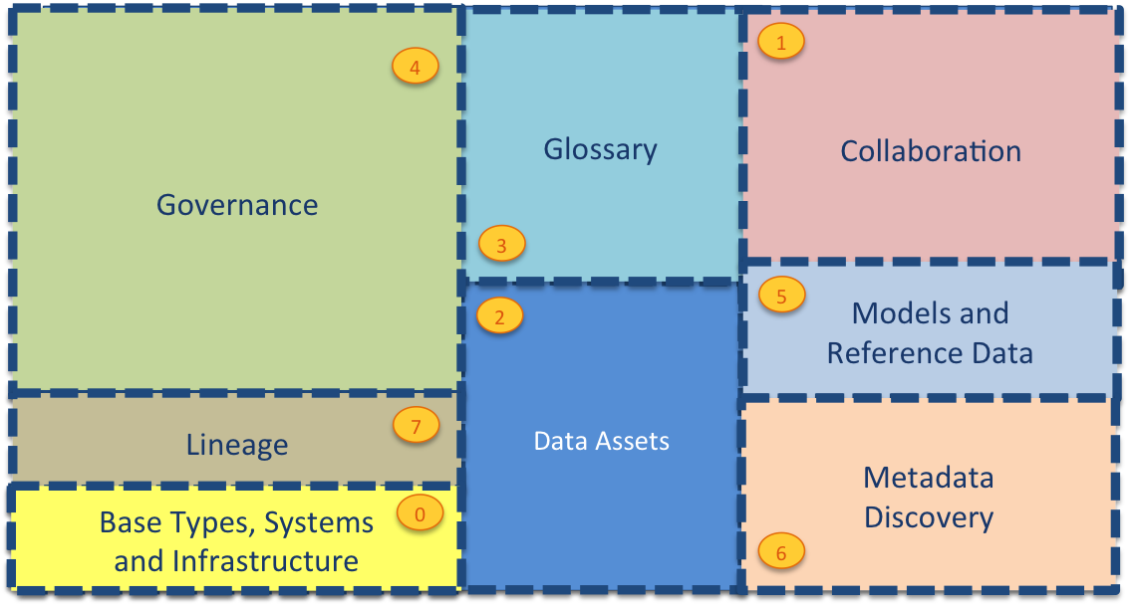
Open metadata data model
Asset Owner
Subject Area Expert
Information View
Asset Catalog
Community
Stewardship
Project Management
Governance Program
Data Science
Data Privacy
Developer
Information Process
Information Landscape
Information Protection
DevOps
Governance Engine
Information Infrastructure
Data Platform
Connected Asset
Asset Consumer
Discovery

Slide 60
Extensions to Egeria
Metadata types for privacy governance
Digital services and their classifications and dependencies (controller, processor, sub-processor.
Assessments, certifications, classification
Open metadata archive
Personal data categories and reference data for data processing descriptions
Data Privacy OMAS
APIs and events for the privacy officer

Slide 61
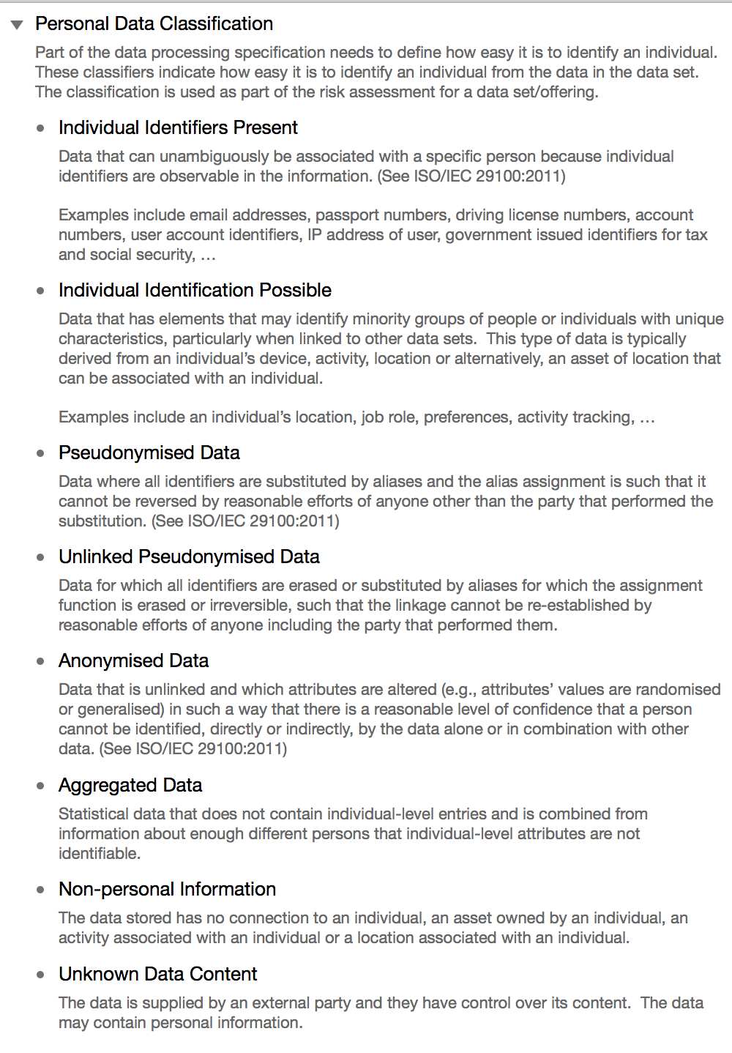
Personal data classification
Individual data sets present a greater risk to the privacy if they contain data elements that uniquely identify an individual.
Some data sets do not explicitly identify an individual, however, they contain values that can be combined with values from other data sets to discover information about individuals – particularly minorities.
The personal data classifications identify how easy it is to discover information about an individual.
They are part of a data set description.

Slide 62
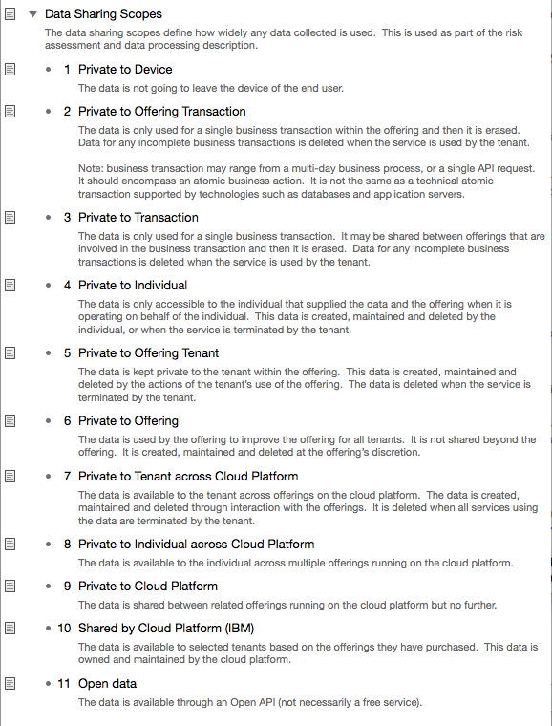
Data sharing scopes
1
2
How widely is the data shared?
Shared data reduces copying and increases the consistency of behaviour that individuals observe when using the platform – but can seem freaky if not expected.
3
4
5
6
7
8
9
10
11

Slide 63
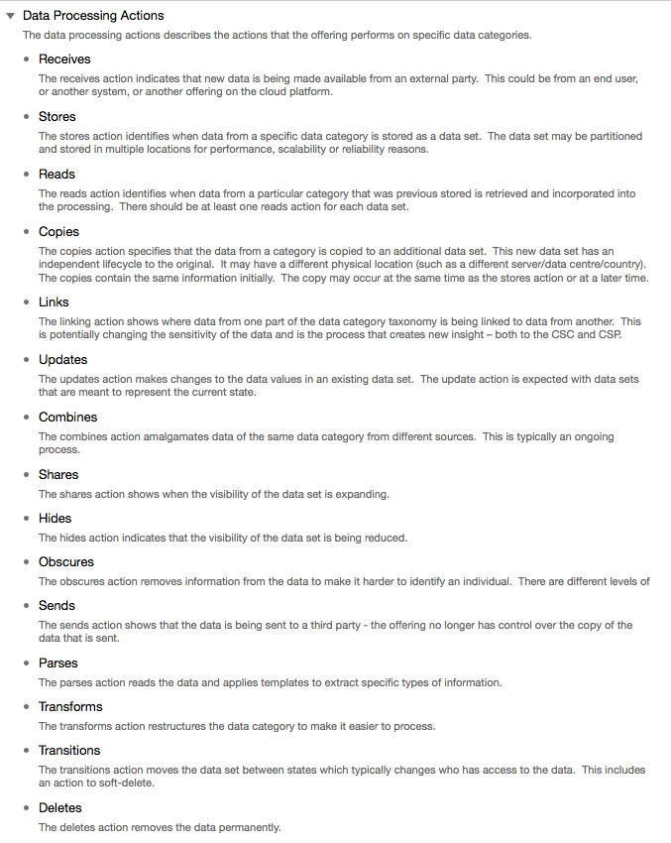
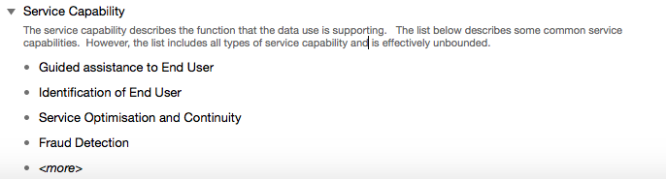
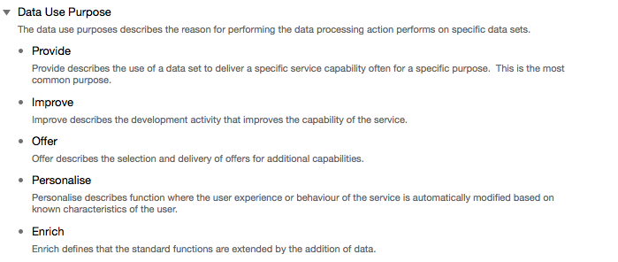
Data processing actions and purposes
The data processing descriptions are formed using keywords for the actions, purpose and the service capability enabled

Slide 64
Summary and next steps

Slide 65
Summary and next steps
Guidance for data privacy is evolving and we will evolve the data privacy pack with it.
Egeria changes rollout
New data types
Data Privacy OMAS
Data Privacy Archives

Slide 66










ODPi - co-creation with practitioners
Compliance assistance and certification for vendors
Subject matter experts sharing best practices and co-creating content packs
Notes:
Mandy prompt Ferd about how involvement of ING has shaped the program and Ferd on how ING benefits from being involved. Please get into business and technical specifics – focus on VALUE derived

Slide 67
z
z
z
z
z
z
z
Questions?

Slide 68
Links
Data Privacy Pack
Coco Pharmaceuticals Persona
Open source repositories
https://odpi.github.io/data-governance/data-privacy-pack/
https://odpi.github.io/data-governance/coco-pharmaceuticals/personas/
https://odpi.github.io/data-governance/roles/
https://github.com/odpi/data-governance
https://github.com/odpi/egeria

Slide 69
